Slide 1

Emotional AI in Healthcare
Transforming Mental Wellness Through Empathetic Innovation and Proactive Care
Presented by: Ankitaa Panpatil

Slide 2
The Transformation of an Industry
In 2026, AI has moved from a promising concept to a practical force in patient care and clinical workflows.

Slide 3

Why Emotional AI?
Closing the Stigma Gap
24/7 Resilience
Digital companions provide a judgment-free environment, encouraging users to open up about mental health concerns earlier than traditional therapy allows.
Crisis doesn't follow a schedule. Emotional AI provides immediate, low-cost intervention when human specialists are unavailable.

Slide 4

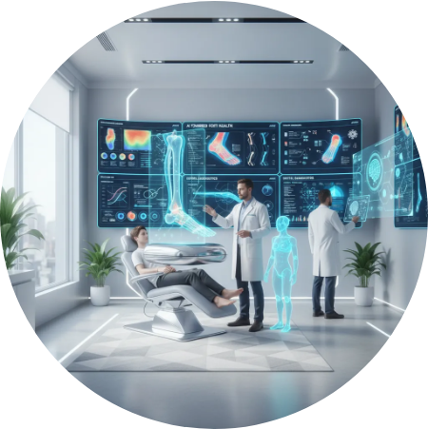
2026 Industry Impact
Personalized Clinical Insight
Mental healthcare institutions now utilize AI co-pilots to synthesize patient behavioral details and biometric logs. This continuous monitoring allows for precision treatment plans tailored to the unique emotional landscape of each patient, moving away from "one-size-fits-all" medicine.

Slide 5
Introducing: MindGuard AI
The proactive mental wellness companion for the modern workforce.

Slide 6
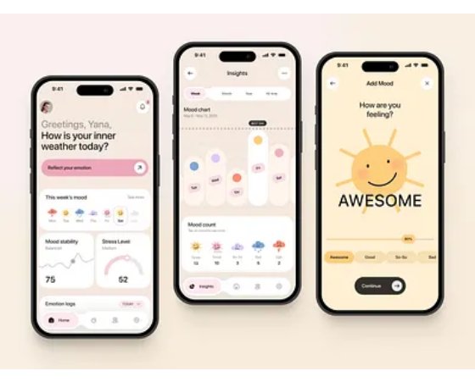
App Concept: MindGuard
Proactive Burnout Prevention
MindGuard is a mobile-first platform designed to detect early indicators of stress and emotional fatigue. Unlike reactive apps, MindGuard uses ambient data to suggest micro-interventions before the user reaches a crisis point.
•
Real-time sentiment mapping
•
Context-aware wellness prompts
•
Biometric feedback loop

Slide 7






Key System Features
Sentiment Analysis
Biometric Sync
Ethical Privacy
Deep learning models analyze speech patterns and text entries to identify shifts in mood over time.
Seamlessly integrates with wearables to correlate emotional states with heart rate and sleep cycles.
Uses local "On-Device" processing to ensure user data remains private and decentralized.

Slide 8
Measuring the Impact
40%
Improving User Experience
Initial pilot studies across three global corporations demonstrated that users who engaged with MindGuard's "Predictive Resilience" features reported significantly lower levels of perceived stress and higher workplace satisfaction.
Reduction in Workplace Burnout

Slide 9
The Evolution of Support
Feature | Traditional Care | MindGuard AI
Availability | Schedule Dependent | 24/7 Real-Time
Cost per Interaction | High ($150+) | Subscription-Based (Low)
Data Type | Self-Reported | Continuous Biometric + NLP
Prevention | Reactive | Predictive & Proactive

Slide 10
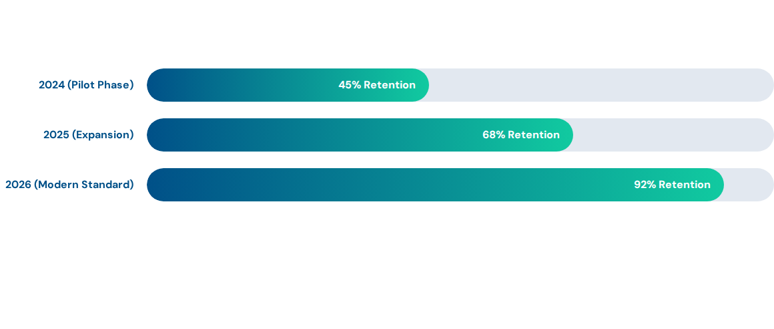
Market Adoption & Engagement
Growth driven by the "Companion Effect" where AI design reinforces positive cognitive habits.

Slide 11
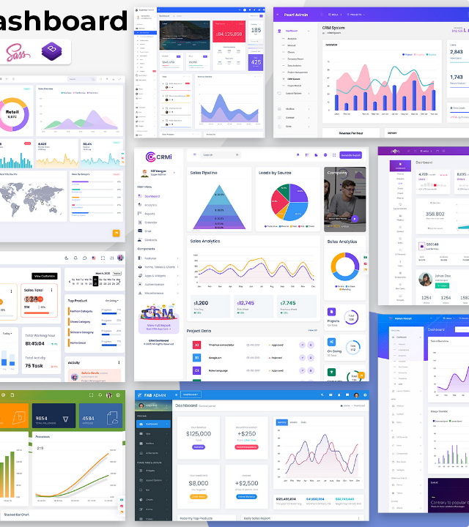
Benefits of Empathetic Tech
Human-Centric Future
Emotional AI is not a replacement for human therapy, but a force multiplier. By providing immediate support and early detection, we free human professionals to focus on deep, complex clinical cases.
Main Benefits:
•
Earlier identification of risk factors.
•
Global accessibility to mental hygiene.
•
Data-backed personalized interventions.

Slide 12
Questions?
Thank you for exploring the future of mental healthcare innovation.
Ankita Mukund Panpatil

Slide 13



Image Sources
https://wetreatfeetpodiatry.com/images/blog/AI-at-WeTreatFeet-Podiatry.webp
Source: wetreatfeetpodiatry.com
https://cdn.dribbble.com/userupload/43686709/file/62a2f7bb3ccc95e3944aa13b92fe567a.jpg?crop=0x0-6402x4801&format=webp&resize=400x300&vertical=center
Source: dribbble.com
https://multipurposethemes.com/wp-content/uploads/2025/03/crm-dashboard-template-feature-images.jpg
Source: multipurposethemes.com

